Slide 1
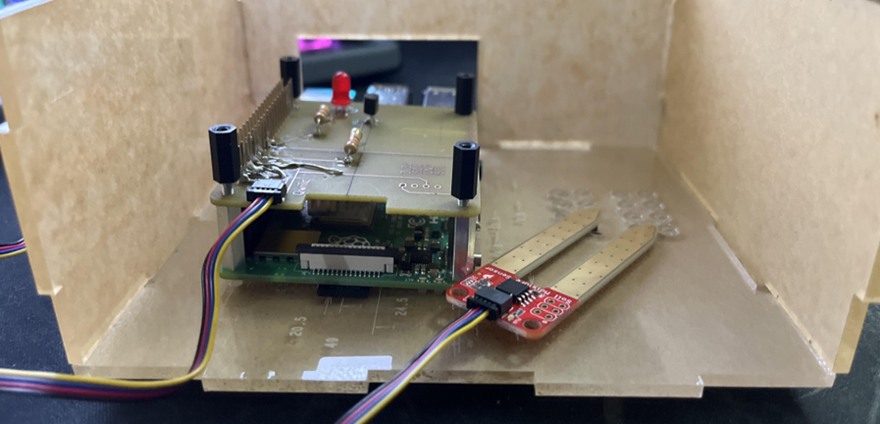
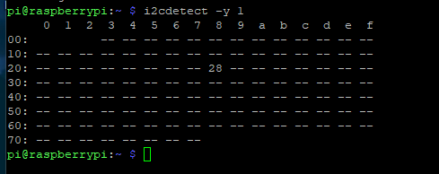
CENG-317 Project
Mi Nam Alcantara (n01451260)
I2C Address: 0x28

Slide 2
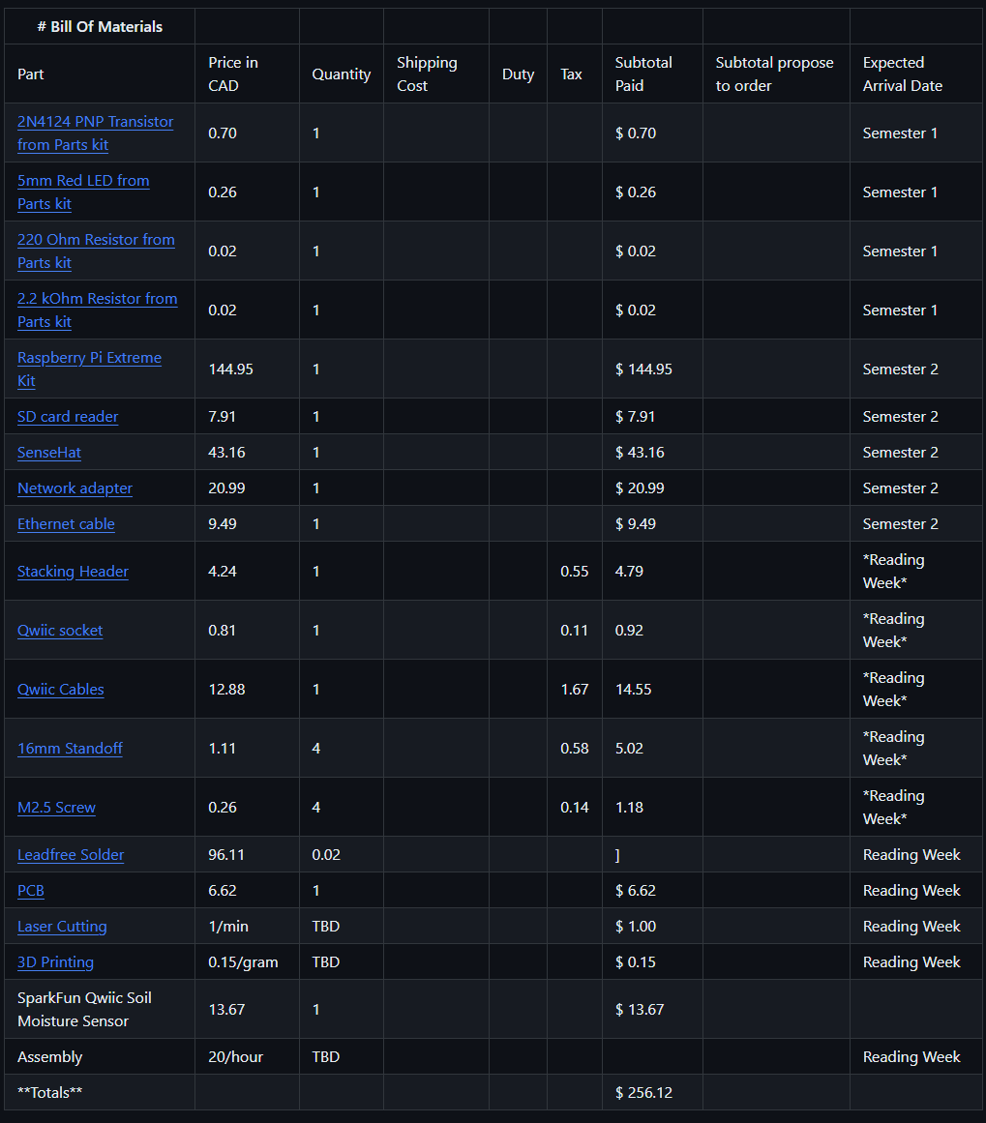
Bill Of Materials
Important Purchases
Qwiic Soil Moisture Sensor $19.99 CAD

Slide 3
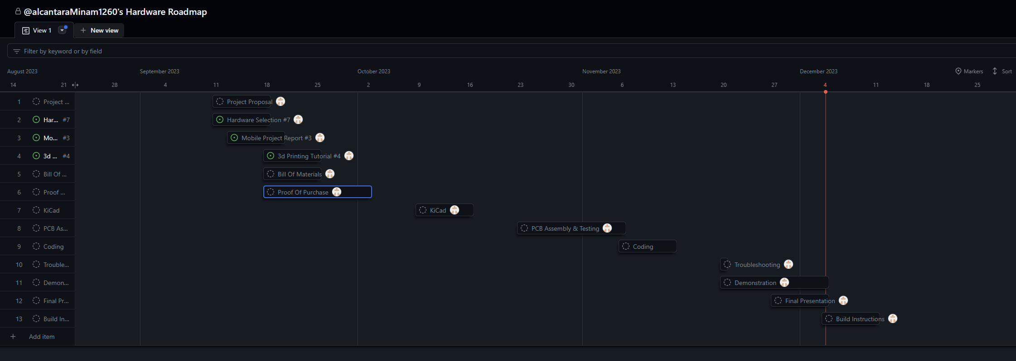
Project Roadmap

Slide 4
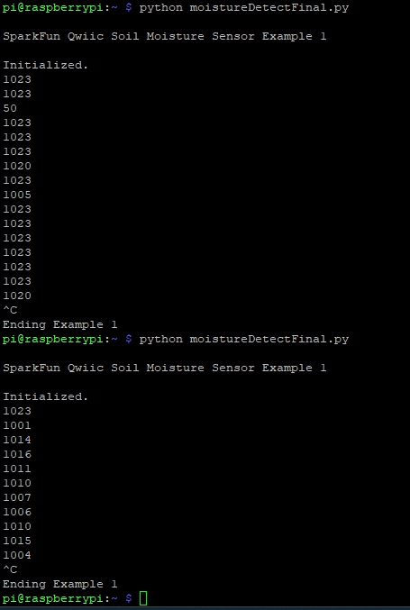
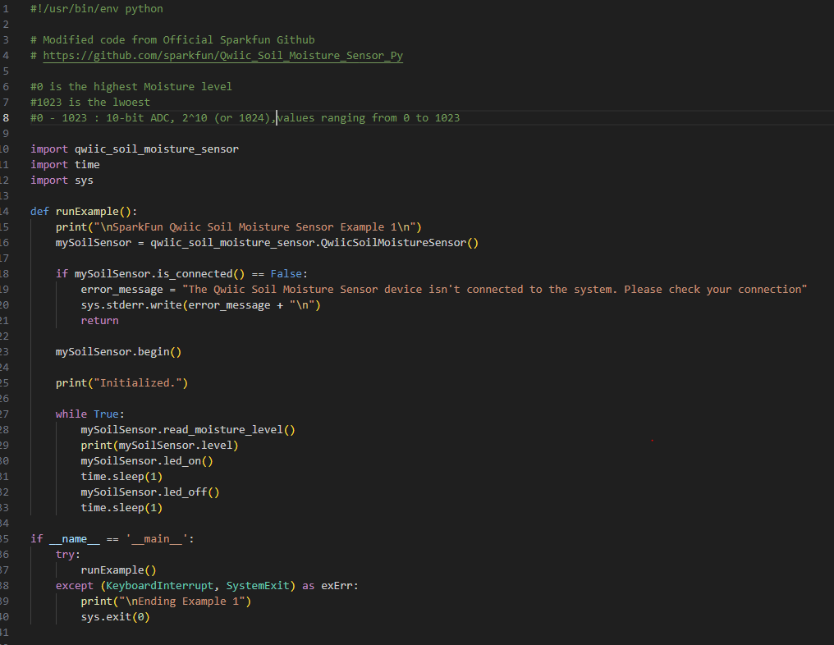
Reading/Writing To Sensor

Slide 5
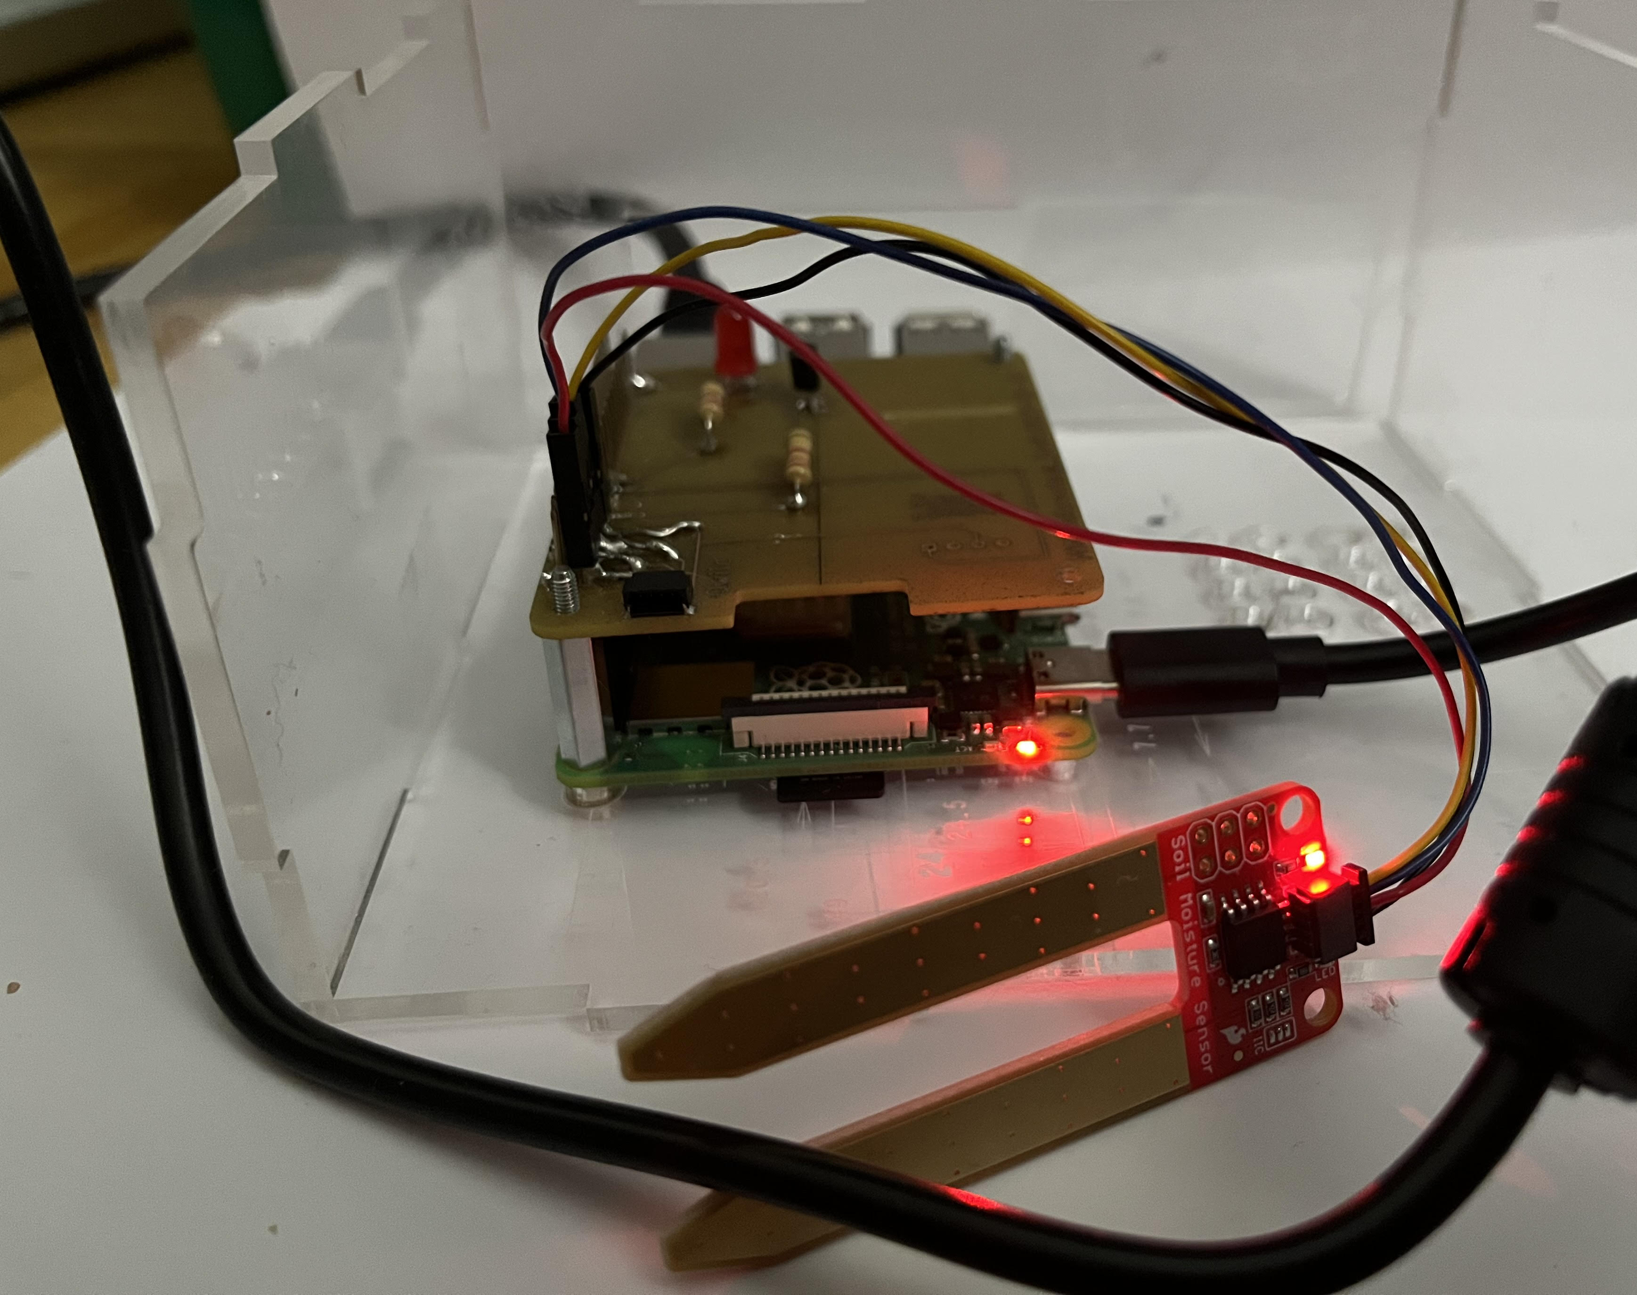
Course Knowledge Utilized
TECH 101, CENG150 (Electric Circuits) (Electrical circuit and board knowledge)
TECH 104, CENG 153 (Programming) (Basic Programming and How to use the Pi)
CENG 252 (Embedded Systems) (How sensors work)

